Slide 1

RAJASTHAN POLICE HACKATHONE 1.0
Problem Statement 4: Analysis of FIR using AI/ML for proper Act and Section
LegalEase Portal
Akshat Sharma Manish Gupta
Prithu Sharma (C) Shruti Khandelwal

Slide 2

Problem Statement
Design a FIR Generation System to enhance the efficiency and accuracy of filing First Information Reports (FIRs) in law enforcement.
The system uses Natural Language Processing (NLP), Optical Character Recognition (OCR), and machine learning techniques to process complainant-provided information and assist in the accurate drafting of FIRs.

Slide 3



Time Efficiency
AI can automate the process, significantly reducing the time required to file an FIR and allowing law enforcement to respond promptly.
Resource Optimization
By automating repetitive tasks, AI allows law enforcement professionals to focus on more complex and critical aspects of their work, optimizing human resources.
Legal Compliance
AI systems can be designed to stay updated with legal amendments, ensuring that FIRs generated are in compliance with the latest legal requirements and standards.

Slide 4


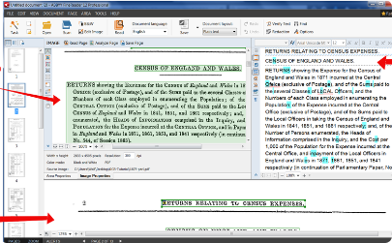
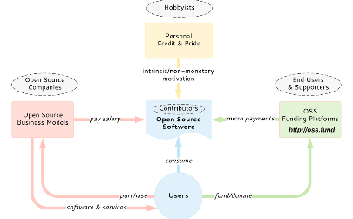
Introduction to OCR:
Optical Character Recognition (OCR)
PDF Text Extraction with Pytesseract
Why Pytesseract in our Project
OCR is an essential technology that converts scanned documents, PDFs, and images into machine-readable and editable text.
Utilizing Pytesseract involves a streamlined process of converting PDFs to images and extracting text.
Pytesseract's open-source nature provides flexibility, allowing customization to meet specific project requirements without licensing constraints.

Slide 5
Text Extraction using OCR
PDF
Complaint
OCR using Pytesseract
Extracted Text
(Hindi)
Translation
to English
Image
Complaint Text (English)

Slide 6
Translation of Hindi text to English
1
Objective
Seamlessly translate large Hindi text blocks to English for enhanced accessibility.
2
2
Implementation
Utilizing deep_translator with GoogleTranslator module, we employ a chunked translation approach.
3
Translation Process
Divide text into 500-character chunks.

Slide 7
Comparing Summarization Models
Models | Duration in Seconds | Drawbacks
facebook/bart-large-cnn | 25-30 | Old model, provides chunks wise summary without context
Gemini-Pro | 5-10 | Blocks sensitive content because of safety measures policy
ChatGPT-3.5 Turbo | 5-8 | Pay to use

Slide 8
Processing Flow
Template Prompting
Model Invocation
Output Parsing
A standardized template prompts the user to provide a summary, excluding sensitive details.
The Google Gemini model is the primary choice, with a fallback to OpenAI if needed.
The generated output is parsed for a clean and concise incident summary.

Slide 9
Vector Database Creation for Indian Penal Code (IPC)
Creating Embeddings for the Indian Penal Code (IPC) using “instructor-xl-large” embedding model and saving them in a locally stored vector database using ChromaDB for easy and efficient semantic search.

Slide 10
Similarity Search in Vector Database
Objective
Vector Database Utilized
Threshold Adjustment:
Execute a similarity search in the Vector Database using summarized complaints to identify relevant IPC documents.
Leveraging the locally stored Vector Database based on the Indian Penal Code (IPC) documents.
The similarity search is fine-tuned by adjusting the threshold, set at 0.75.
This threshold determines the level of similarity required for a match.

Slide 11
Current Challenges
Future Scope
Multiple Language Support
Using Cloud Storage for storing embeddings
Poor performance of Open-Source models for summarization
Handwritten Text Extraction
Fine-tuning open source LLMs

Slide 12

THANK YOU

